Slide 1
Static Routing

Slide 2
Basic Routing Using Two Routers

Slide 3
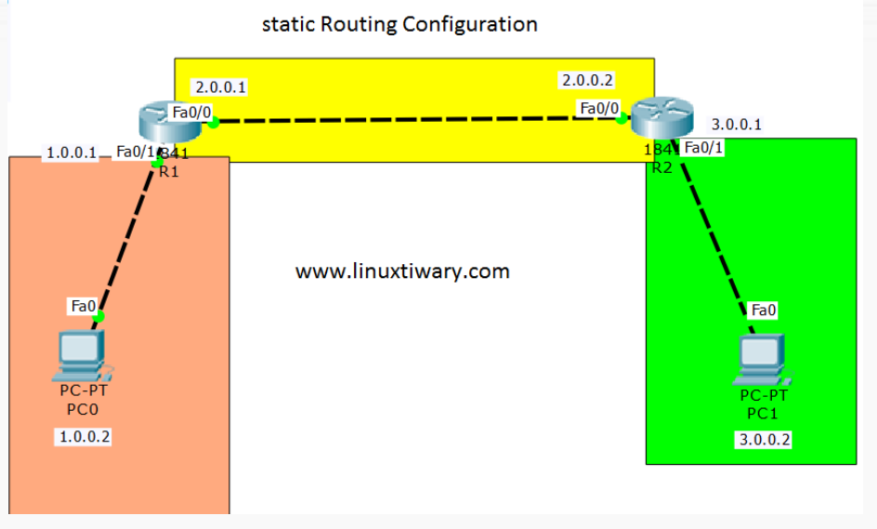
Our Configuration

Slide 4
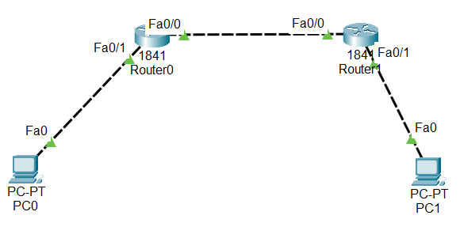
Step 1: Create Basic Topology

Slide 5
Step 2: Assign Static IP Addresses
PC0: 1.0.0.2
Router0 Fa0/1: 1.0.0.1
Router0 Fa0/0: 2.0.0.1
Router1 Fa0/0: 2.0.0.2
Router1 Fa0/1: 3.0.0.1
PC1: 3.0.0.2

Slide 6
Step 3: Add Static Routing
Add static routes to the two routers:
Router 0: ip route 3.0.0.0 255.0.0.0 2.0.0.2
Router 1: ip route 1.0.0.0 255.0.0.0 2.0.0.1

Slide 7
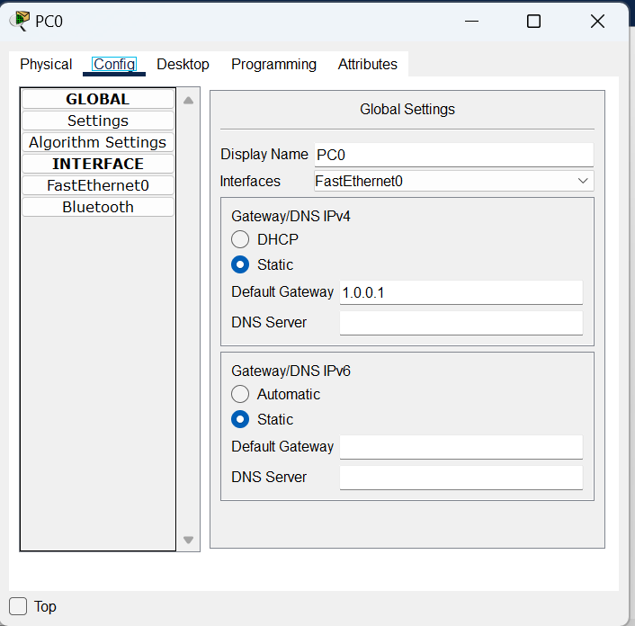
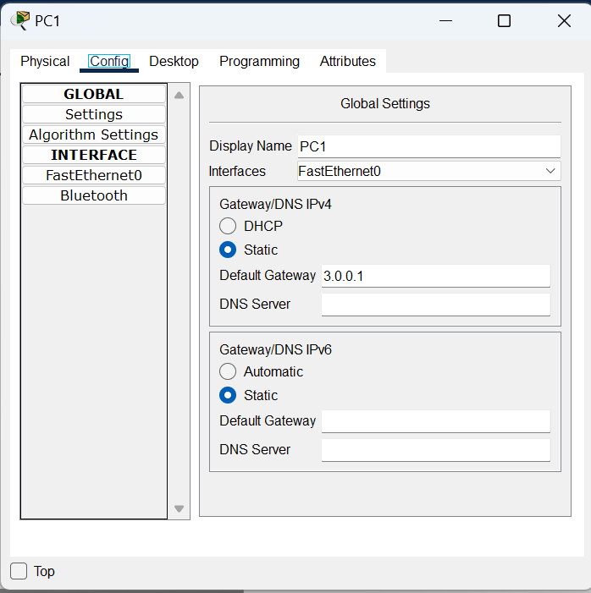
Step 4: Add Default Gateways

Slide 8
Static Routing Concept
We need to manually add routing information to the routers
Routers do not automatically create/update routing information
Easy but not efficient
Can be used for small networks

Slide 9
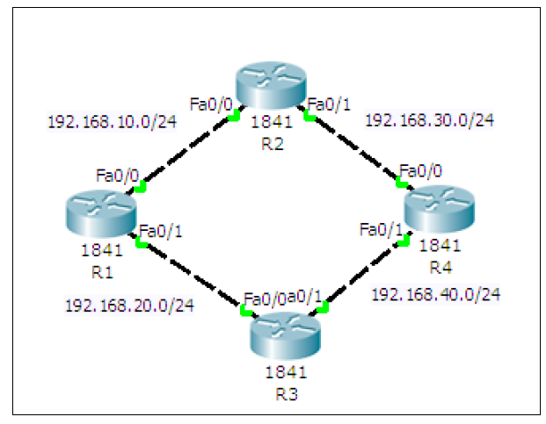
Static Routing Setup
Create a ring topology
(Next slide for details)

Slide 10
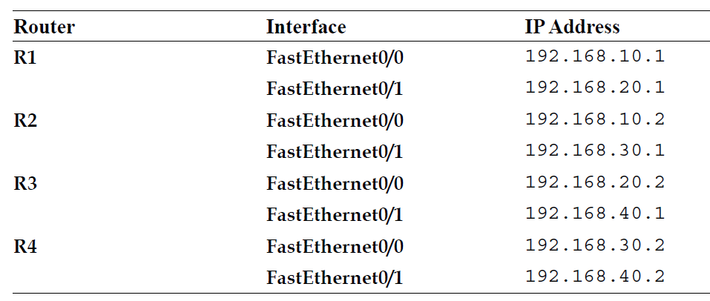
Creating the Ring Topology
Add four routers with the following details – Make sure Port is On

Slide 11
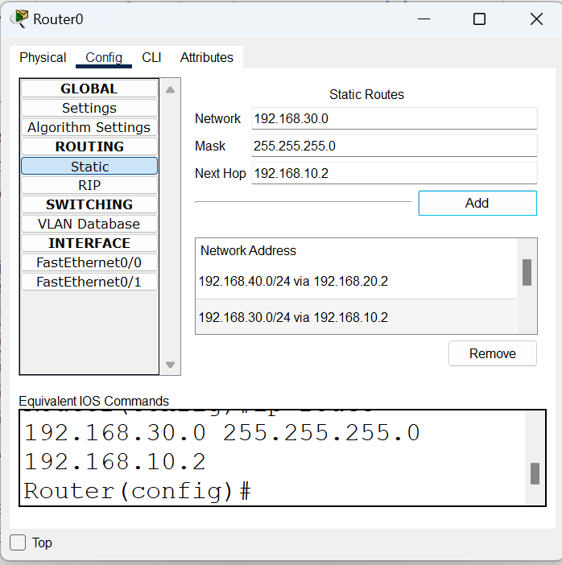
Configuring Routes Statically
Open the first Router (Router 0) and in Routing, add the routes
Enter the details here and click on Add

Slide 12
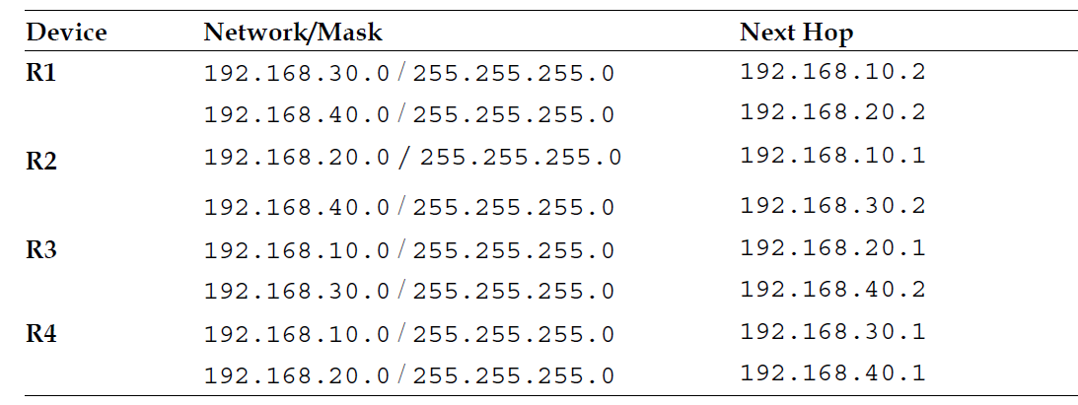
Similarly, for the Others, Add Information as Below

Slide 13

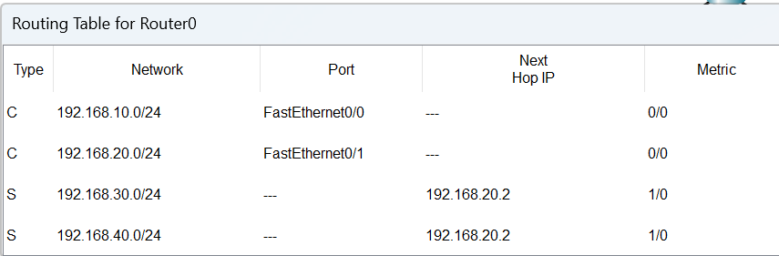
Checking Routing Table
We can examine any router’s routing table by clicking on the search button (called Inspect) on the top left corner of the screen
and then selecting a router

Slide 14
Testing
Add a simple PDU from the menu to any two routers and see if they can route the packet correctly or not

Slide 15
Dynamic Routing

Slide 16
Dynamic Routing
Routing Information Protocol (RIP) is used by routers to exchange information so as to build routing tables
We do not have to add routing information statically now
Routers automatically do this

Slide 17
Configuring RIP
1. Create the same four-router topology we used previously and assign the same IP addresses through the Config tab.

Slide 18
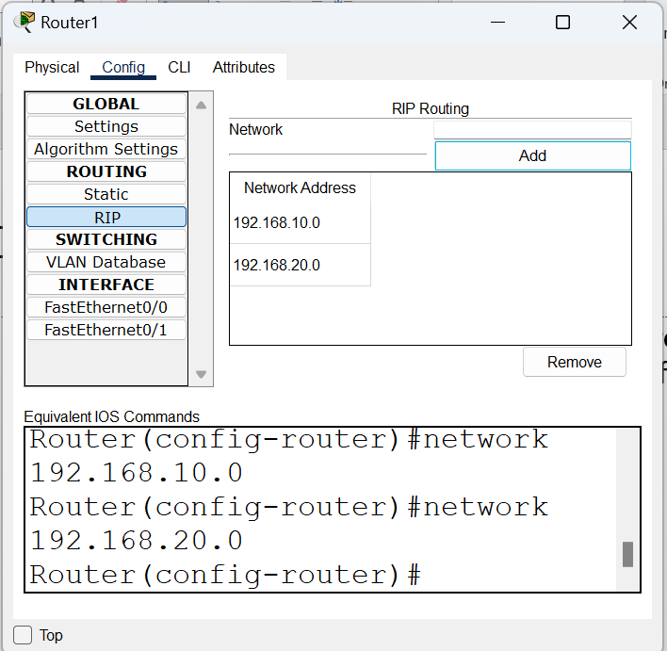
Configuring RIP
2. Click on RIP. This is very easy. Each router now requires only the Network IP of its own interfaces, as shown in the following screenshot:
Full list – next slide

Slide 19
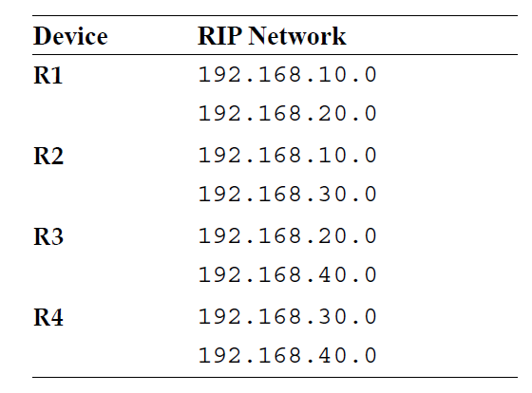
Network Addresses for RIP Configuration

Slide 20
Test using the PDU
Same as before

Slide 21
Dynamic Host Configuration Protocol (DHCP)

Slide 22
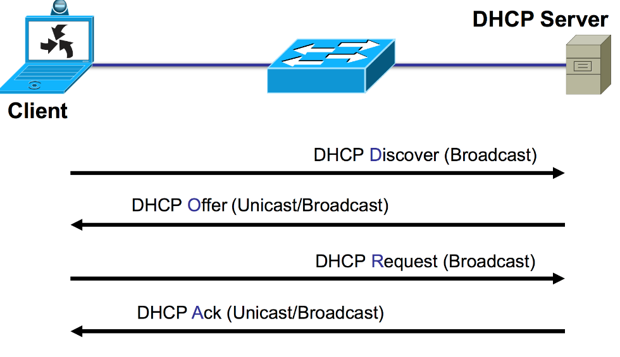
DHCP Concept
Dynamic Host Configuration Protocol (DHCP) is a client/server protocol that automatically provides a host with its IP address and other related configuration information such as the subnet mask and default gateway.
DHCP clients obtain their IP configuration information from a DHCP server, rather than being manually configured.

Slide 23
Configuring DHCP – Two Options
Use a router also as a DHCP server
Use an external sever for this job
We will try Option 1

Slide 24
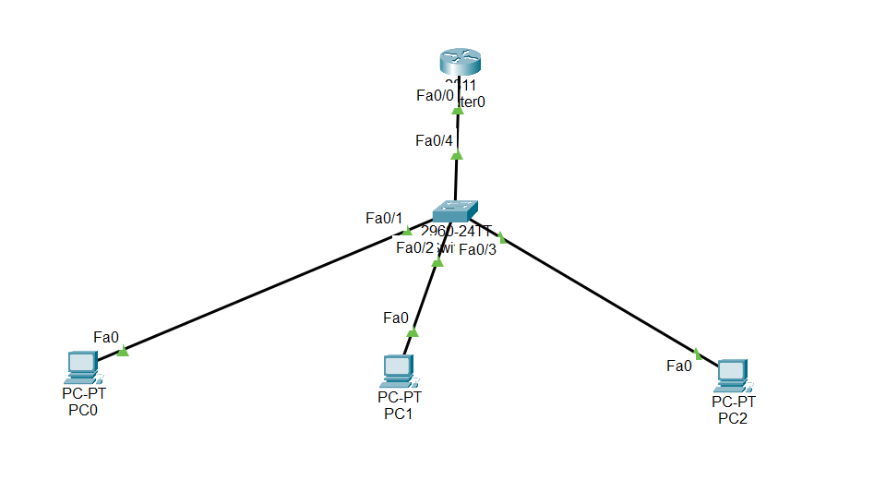
Hands-on
Create this
Switch should be 2960
Router should be 2811

Slide 25
Step 2: Give an IP Address to the Router
Router>en
Router#config t
Enter configuration commands, one per line. End with CNTL/Z.
Router(config)#int fa0/0
Router(config-if)#ip add 192.168.1.1 255.255.255.0
Router(config-if)#no shutdown
Router(config-if)#
%LINK-5-CHANGED: Interface FastEthernet0/0, changed state to up
%LINEPROTO-5-UPDOWN: Line protocol on Interface FastEthernet0/0, changed state to up

Slide 26
Step 2: Configure Router – DHCP Part
Router(config)#ip dhcp pool MY_LAN
Router(dhcp-config)#network 192.168.1.0 255.255.255.0
Router(dhcp-config)#default-router 192.168.1.1
Router(dhcp-config)#dns-server 192.168.1.10
Router(dhcp-config)#exit
Router(config)#ip dhcp excluded-address 192.168.1.1 192.168.1.10
These addresses should not be used by the DHCP server (may be they are already statically allocated in the network to some devices)

Slide 27
Step 3: Change all PC Address Types to DHCP
Click on PC0 – Config – FastEthernet0 – Change IP Configuration from Static to DHCP
Repeat for the remaining PCs

Slide 28
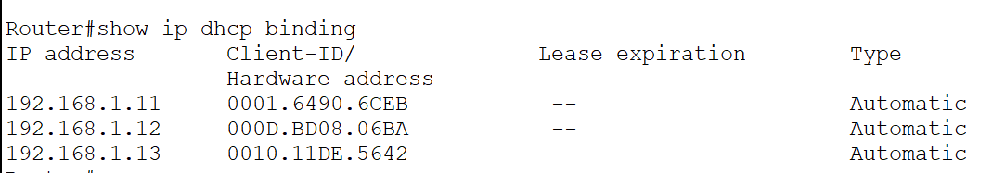
Verify
Exit twice in the router CLI to go to the Router# prompt
Enter command show ip dhcp binding
Also verify by checking the config of individual PCs

